Slide 1


Revolutionizing Reverse Logistics
An Analysis of Closed-Loop Supply Chains & Strategic Partnerships
Dell Case Competition - Group 16

Slide 2
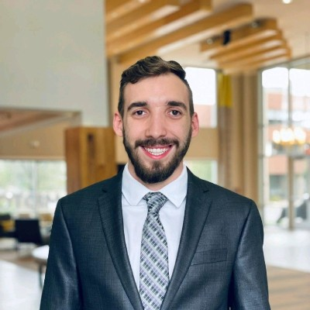







The Team
Michael Cooper
Robert Rasmussen
Eleonora Scardini
Alexandre Tilly
Supply Chain Management
Mathematics & Economics
Accounting
Finance & Supply Chain Management

Slide 3
Bottom Line, Up Front
The Growing Intersection
The intersection between sustainability and reverse logistics is growing, which prompts the need for a closed-loop supply chain and the optimization of close customer relationships.
Closed Loop Supply Chain
Minimization of waste has an effect on the current shortages & supply chain disruptions. Dell can take use of this type of sustainability initiative to incentivize the end users to remain loyal to the Dell brand.
First Mile Back
The last mile is the focus of forward logistics, however the first mile back to the firm in reverse logistics is yet another contact point for the consumer. Oversight and enhancement of customer relationships will create lasting value and create a resilient supply chain.

Slide 4

Market Trends & Conditions

Slide 5
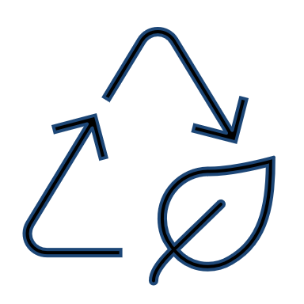


Technology and Industry Trends
Waste Reduction & Product Recycling
Changing Product Design: Redesigning products and packaging to minimize waste and maximize recyclability.
Closed Loop Supply Chain: Optimizing products and procedures to incentivise customers to return and upgrade products.
GlobalTranz, 2020
Shift to Cloud-Based Digital Services
Predictive Analytics: AI and machine learning can be applied to automate processes with environmental impact and predict maintenance.
Cloud Services: Shift from solely hardware reliant data storage to hybrid and cloud systems
JD Supra, 2020 and SiliconAngle, 2020
ESG Reporting & Transparency
Increasing Transparency: Transparency in reporting keeps companies on track to meet green commitments and drives competition.
Fosters Trust with Stakeholders: Transparency fosters trust with the public as demonstrated by companies with superb reporting.
KPMG, 2020

Slide 6
Sustainability & Reverse Logistics Intersection
Reverse Logistics
Performance
Government
Regulations
Growing Awareness of Returns & Waste
Economic Performance
Monetary returns & firm opportunities
Environmental Performance
Focus on the impact on the earth
Social Performance
Stakeholder consideration
The Triple Bottom Line
Sustainability Driven Legislation in the European Union
Circular Economy Package
USB-C chargers & the European Commission
Allowance of Participation in Development of Environmental Law
Currently over 150 countries
Growing Returns & Waste
3.5B products returned every year, 4B lbs of waste, and 11MMT of GHG emissions (ECG & Optoro)
Growing Awareness & Company Reporting
80% of G-250 conduct sustainability reporting (KPMG, 2020)
“The main goal of sustainable development is to draw attention to environmental, social and economic aspects”
-Ali, Barakat, Zalavadia (2018)
“We gave industry plenty of time to come up with their own solutions, now time is ripe for action ”
-VP Margrethe Vestager (2021)
“Waste occurs at every node in the reverse supply chain: damaged goods, disposal of inventory...”
-Optoro (2016)

Slide 7
Proposed Solutions

Slide 8
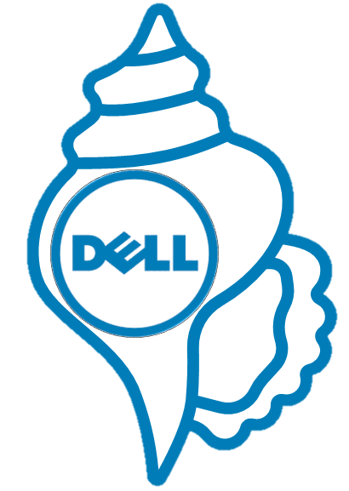
How Front-End Design Impacts Back-End Sustainability
Fully customizable modular design
Focused on user ease-of-access
Enables potential for strategic partnerships with suppliers and 3PLs
Optimizes closed-loop supply chains

Slide 9

Partnership with Amazon Home Services
Dell-certified independent contractors available on demand
Proximity to clients, easily purchasable universal parts
Meet increasing demand for speed and convenience
Risk mitigation and preparedness with data sharing
Dell-owned hubs reduction
Decentralization reduces need for Dell-operated hubs
Reduction in power consumption and carbon footprint
Dell certifications in trade schools and community colleges
Career-oriented skills available to all income learners
Qualified labor, workforce empowerment
CONSUMER REPAIR EXPERIENCE:
“THE FIRST MILE BACK”

Slide 10
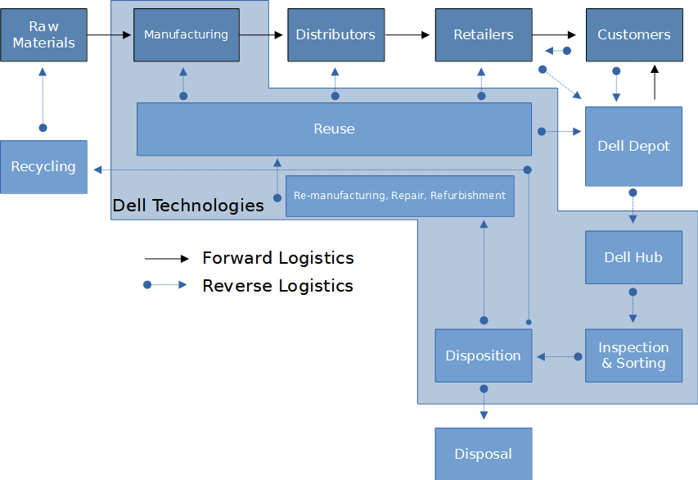
DELL REVERSE LOGISTICS - 2021 REALITY
Adapted from Agrawal et al. (2015) &
Dell Electronics Disposition Policy (2019)

Slide 11

DELL REVERSE LOGISTICS - 2026 VISION
Adapted from Agrawal et al. (2015) &
Dell Electronics Disposition Policy (2019)

Slide 12

DELL REVERSE LOGISTICS - 2031 VISION
Adapted from Agrawal et al. (2015) &
Dell Electronics Disposition Policy (2019)

Slide 13

The Dell shell’s Impact on Sustainability
Carbon Footprint
Modularity allows for components with higher carbon footprints to be manufactured less often
Recyclability
Simpler upgrades coupled with incentives will lead to higher rates of product recovery and recyclability
ESG Reporting
Increased visibility into a component’s end-life will allow for more accurate reporting
Aligning Green Goals
Dell will have increased bargaining power throughout the supply chain pushing us to a net zero carbon future
Notes:
Closed Loop Supply Chain
Redesigning tower and laptop computers from “Black Box” machines to a user-friendly modular design will enable customers to upgrade incrementally as new components come out
To incentivize customers to return hot-swapped parts the “Dell Shell” plan allows for discounts/credits for customers who send back the obsolete component being replaced
This, in conjunction with ease of component removal, will enable Dell to build out a closed loop supply chain allowing for high rates of part recycling.
This closed loop will increase supply chain visibility as it will maximize the number of recycled components, this will enable more transparent and effective ESG reporting and capitalize on Dell’s core value of Integrity
Further, allowing for incremental upgrades will reduce waste when upgrades come out as customers will not need to get an entirely new computer

Slide 14
REVERSE SUPPLY CHAIN RESILIENCE
Modularity decentralizes customer requirements, enabling easier accessibility to alternatives
Strategic partnerships with leading components manufactures increasing visibility
Decentralized warehouses increase redundancy ensuring business continuity
“The greatest danger in times of turbulence is not the turbulence – it is to act with yesterday’s logic.”
-Peter Drucker

Slide 15

Questions?

